Slide 1
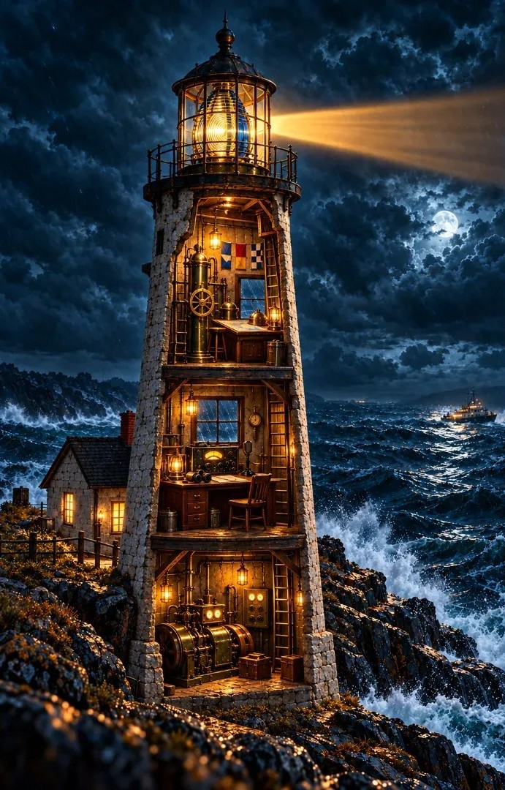
Light the Beacon
GRADE 6 · RATIOS AND RATES
Ratios and Rates to the Rescue
Day 1 · Story: The Keeper’s Logbook
Day 1 · Lesson 1: Building the Toolkit
Day 2 · Lesson 2: The Escape
Day 2 · Lesson 3: Signal Debrief
Notes:
Use this deck alongside the Light the Beacon Teacher Guide. Day 1 is the story and Lesson 1. Day 2 is the escape room (Lesson 2) and the debrief (Lesson 3). Speaker notes carry expected student answers.

Slide 2

Two Days at Gull Point
DAY 1
DAY 2
Story
Read The Keeper’s Logbook and meet the words you’ll need.
Lesson 2
Play all four rooms of the escape room in one class period.
Lesson 1
Practice the three tools the escape room uses.
Lesson 3
Compare strategies and talk about why your answers worked.
Notes:
Day 1: the story introduces the vocabulary and sets up the mission; Lesson 1 practices the skills. Day 2: pairs play all four rooms in one class period, then debrief. On 45-minute periods, teach each lesson in its own period.

Slide 3

The Keeper’s Logbook
DAY 1 · STORY
Meet Mira, Pop and the lighthouse at Gull Point
Notes:
About 30 minutes: words to listen for and before-reading questions (8), the story (15), after reading (7). Read aloud, have students take turns, or let partners read on their own devices. Pause after each scene for 30 seconds of partner talk. Don’t solve any puzzles during the story.

Slide 4
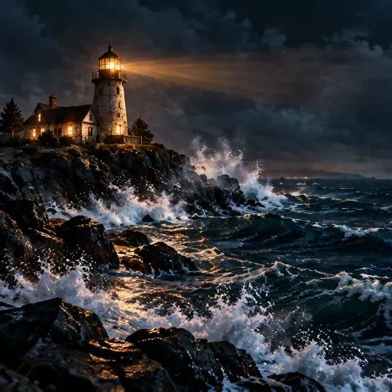
Before We Read
What is a lighthouse for?
How could a ship tell one lighthouse from another at night?
Listen for the tools the keeper uses. Why do you think a lighthouse might need math?
Notes:
What is a lighthouse for? It warns ships about rocks and guides them to shore.
How could a ship tell one lighthouse from another at night? Different colors, flash patterns, or timing.
Say: Today’s story is about a lighthouse that runs on math. Listen for the tools the keeper uses.

Slide 5

Words to Listen For
You’ll hear these words in today’s story, and you’ll use them again in the escape room.
Math words
Story words
Ratio
Part-to-part
Part-to-whole
Beacon
Reef
Equivalent ratios
Ratio table
Tape diagram
Lens
Double number line
Rate
Unit rate
Generator
Logbook
Notes:
Read the words aloud together. Say: These words come up in today’s story, and you’ll use them again in tomorrow’s escape room. Listen for them.
After the story, students write three of them in their own words on the Word Bank {S-1}.

Slide 6
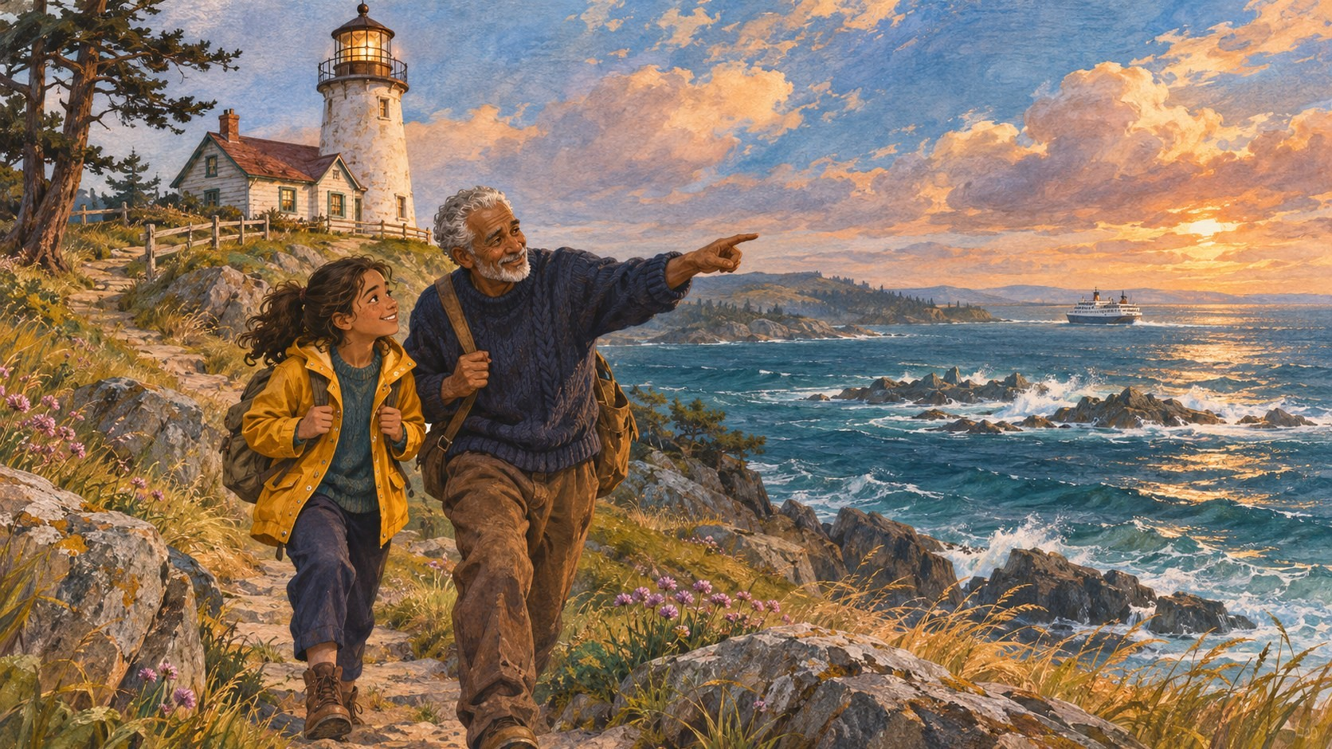
Gull Point
SCENE 1 OF 8
Mira had never seen the ocean look so restless. From the trail, she could see Gull Point Light standing on the rocks, its white tower glowing in the late sun.
Her grandfather, Pop, had kept the light for thirty years. "A beacon is a promise," he told her as they climbed the hill. "Every ship out there trusts it to say: rocks here, stay clear."
Below them, waves broke white over the reef, a ridge of rock hiding just under the water.
Talk about it: Why would a ship need to trust the beacon?
Notes:
Read aloud, or have a student read. Vocabulary: beacon (a strong light used as a signal or warning) and reef (rock just below the water that can wreck ships).
Ask: Why would a ship need to trust the beacon? It warns ships away from the reef, especially at night or in a storm.

Slide 7
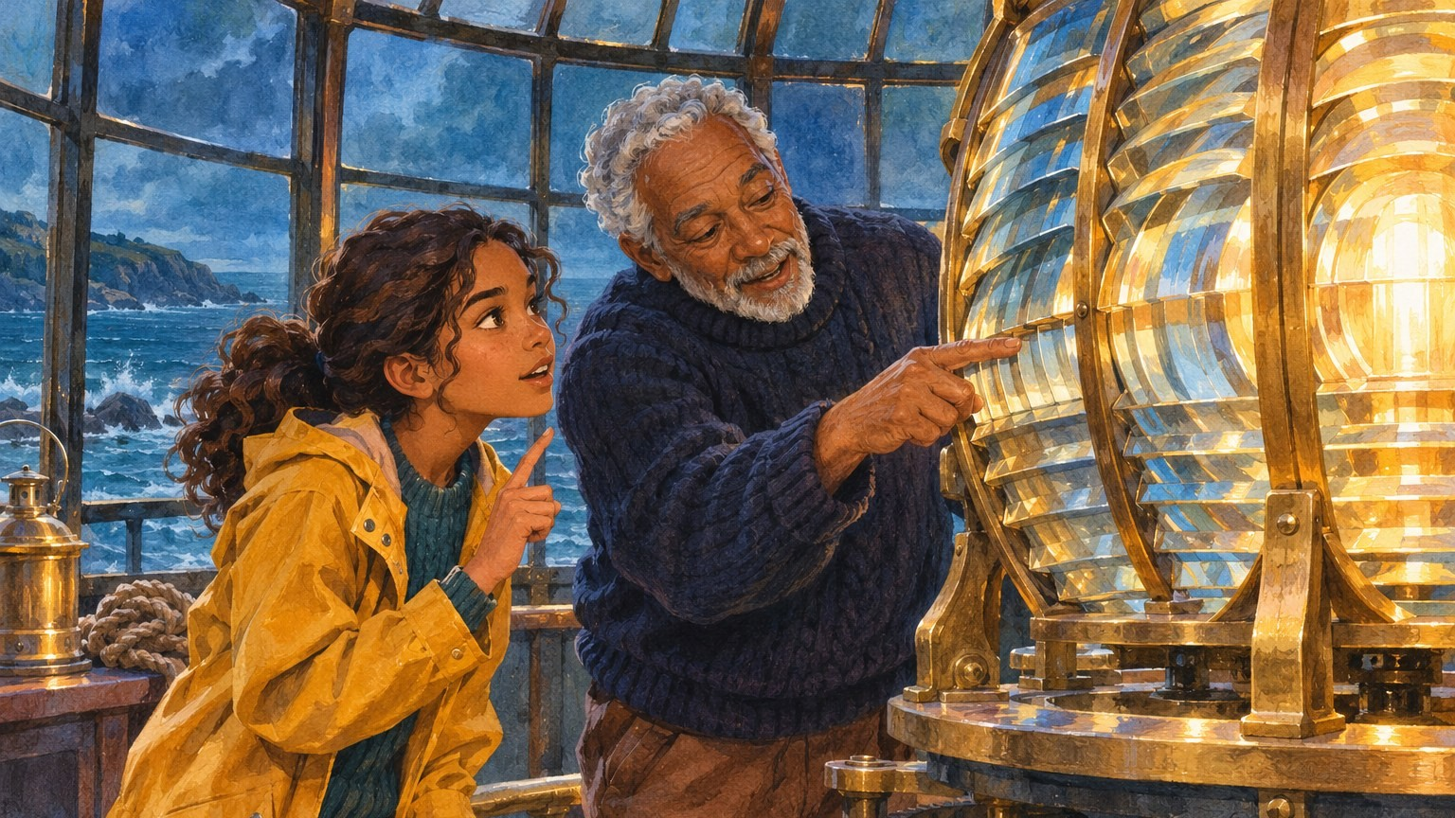
The Lantern Room
SCENE 2 OF 8
At the top of the tower stood the lens: a giant glass beehive of blue and gold panels.
"Every lighthouse has its own pattern," Pop said. "Ours is 2 blue for every 3 gold. That's a ratio. Ships learn it by heart."
"So if you mixed it up, 3 blue for every 2 gold, it would be a different lighthouse?" Mira asked.
"Exactly. In a ratio, order matters."
Talk about it: What does "2 blue for every 3 gold" tell you? What would 3 blue for every 2 gold look like?
Notes:
Vocabulary: lens, ratio, and "for every" language. Point out that the order of the numbers matches the order of the words: blue first, then gold.
Expected answers: In each group of 5 panels, 2 are blue and 3 are gold. 3 : 2 would be mostly blue, a different signal.

Slide 8
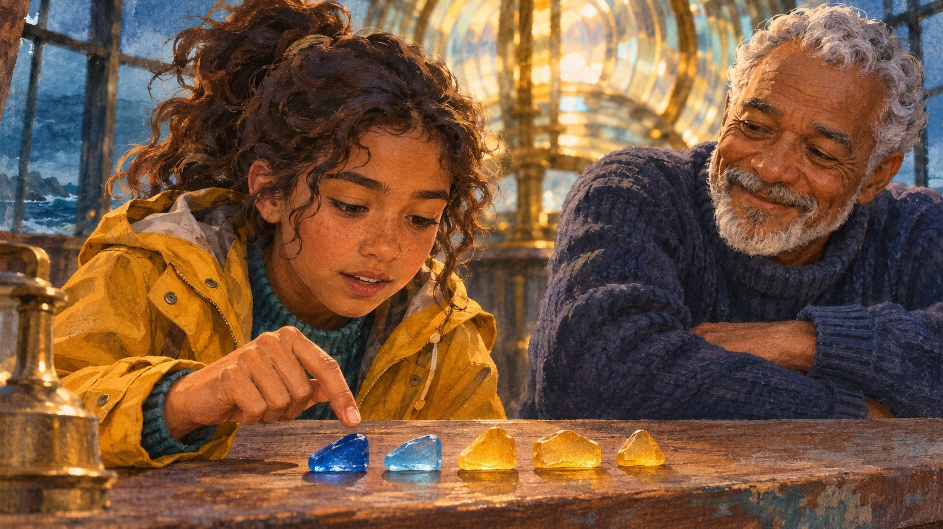
Parts and the Whole
SCENE 3 OF 8
Pop set five pieces of sea glass on the table: two blue and three gold, like one group of panels in the lens. Mira pointed at each one. "So 2 out of every 5 are blue."
"Now you're comparing a part to the whole group," Pop said, smiling. "2 blue to 3 gold compares part to part. 2 blue out of 5 compares part to whole. Both are true. They just answer different questions."
Mira squinted at the huge lens. "And the big lens is just lots of those little groups?"
"Now you're thinking like a keeper."
Talk about it: How is "2 blue to 3 gold" different from "2 out of 5 are blue"?
Notes:
Vocabulary: part-to-part and part-to-whole.
Expected answer: 2 : 3 compares the blue panels to the gold panels. "2 out of 5" compares the blue panels to all the panels in the group.
This idea helps in the Lens Room, but don't solve the 20-spot lens here.

Slide 9

The Keeper's Logbook
SCENE 4 OF 8
Pop opened a thick leather logbook. Inside were tables of numbers and long strips divided into boxes.
"When something works, I write down the pattern," he said. "This is a ratio table. Every column follows the same pattern. 2 and 3, then 4 and 6, then 6 and 9."
"Those are equivalent ratios," Mira said. "Same pattern, bigger numbers."
"Right. You multiply both numbers by the same amount. Never just add."
Talk about it: Why does Pop say to multiply and never just add?
Notes:
Vocabulary: logbook, ratio table, equivalent ratios. The strips with boxes are tape diagrams.
Expected answer: Multiplying both numbers by the same amount keeps the pattern. Adding the same amount changes it. Example: 2 : 3 plus 1 each is 3 : 4, which is a different pattern.

Slide 10
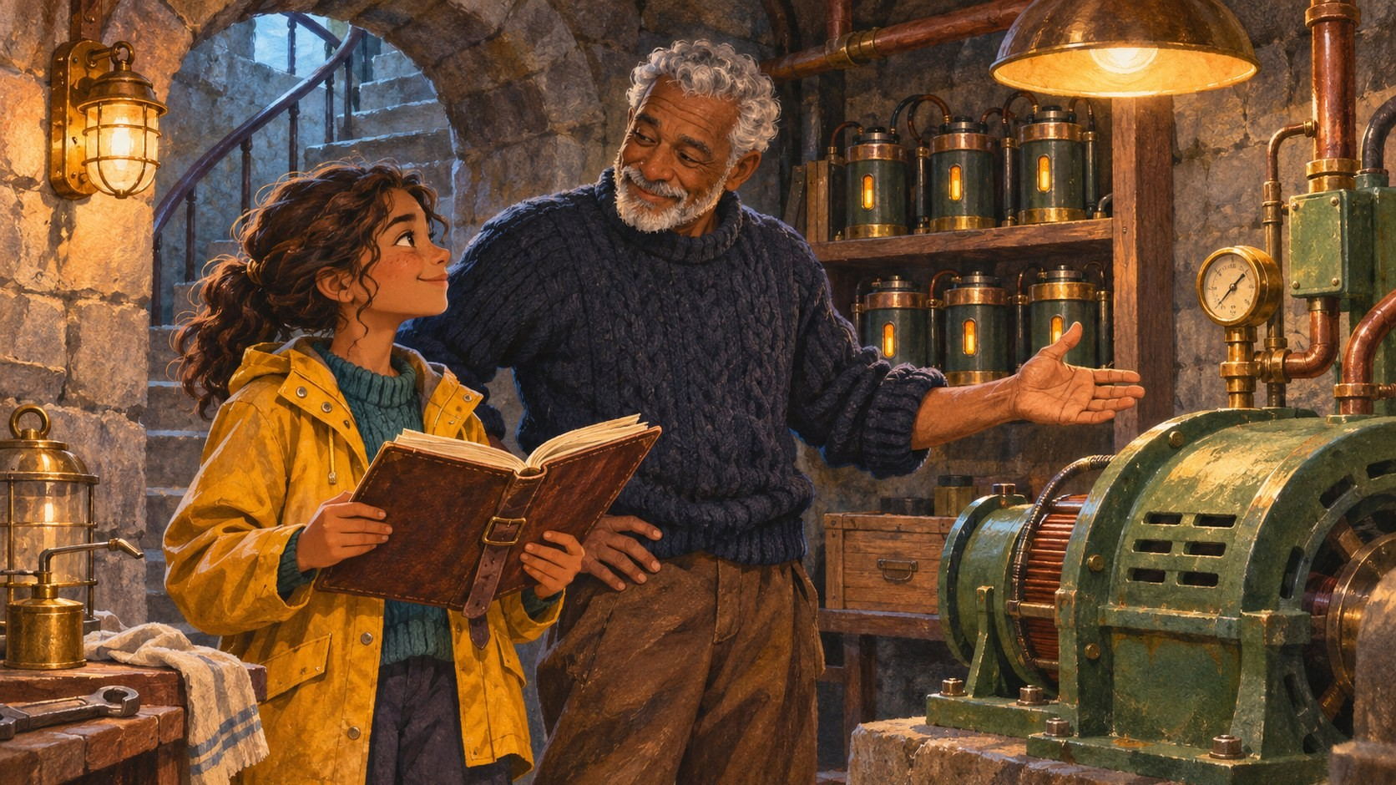
The Generator Room
SCENE 5 OF 8
Deep in the basement, a green iron generator hummed. Rows of power packs lined the shelf.
"The generator turns power packs into flashes of light," Pop said. "Each pack gives the same number of flashes, so packs and flashes always stay in the same ratio."
Mira looked at the logbook. "So if you know how many flashes a few packs make, you can find it for any number of packs?"
Pop tapped the ratio table. "That's what this is for."
Talk about it: If packs and flashes stay in the same ratio, how could a ratio table help you?
Notes:
Vocabulary: generator. Reinforce the ratio table.
Expected answer: You can fill in new columns for different numbers of packs by multiplying, or by adding two columns you already know.
Don't give the game's numbers (4 packs make 6 flashes) yet; students meet them in the Generator Room.

Slide 11
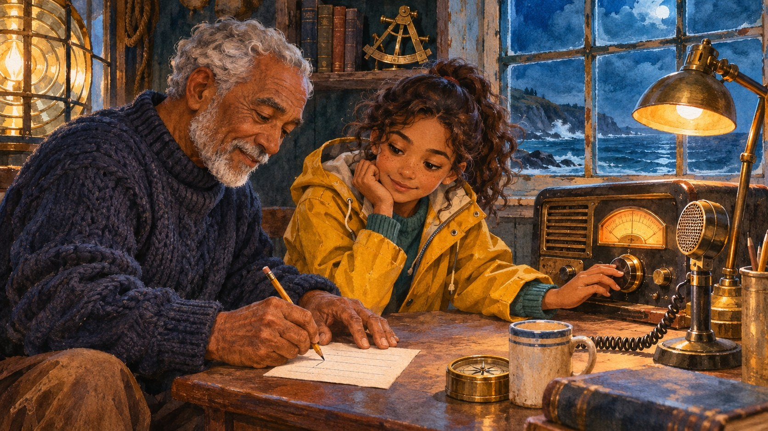
The Radio Room
SCENE 6 OF 8
Halfway up the tower, an old radio sat by the window. It sent messages in steady beeps.
"Beeps per minute," Pop said. "That's a rate: it compares two different things, beeps and minutes. And the beeps in just one minute is the unit rate."
He sketched two lines on a scrap of paper, minutes on top and beeps below, with matching marks. "A double number line. Once you know the unit rate, you can tell how long any message will take."
Talk about it: Why is the unit rate so useful?
Notes:
Vocabulary: rate, unit rate, double number line.
Expected answer: Once you know the amount for 1 minute, you can find the amount for any number of minutes, or the time for any number of beeps.

Slide 12
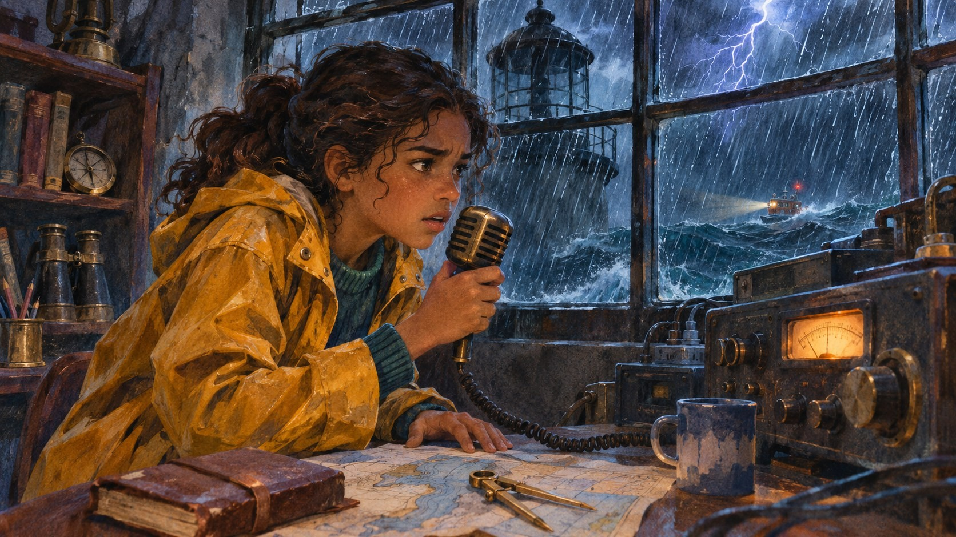
The Storm
SCENE 7 OF 8
That night, the storm arrived. Rain hammered the glass. Then lightning cracked so close that the whole tower shook.
The light went out.
The radio crackled. It was Pop, who had gone to help at the harbor. "Mira! The rescue boat Sea Wren is heading for Gull Point, and they can't see the reef. The lens is cracked, the generator is down, and the radio needs a new message. I can't get back in time."
Talk about it: What three things are broken? What does the Sea Wren need?
Notes:
Build suspense here. Expected answers: the lens, the generator and the radio. The Sea Wren needs the beacon so it can see the reef and steer clear.

Slide 13
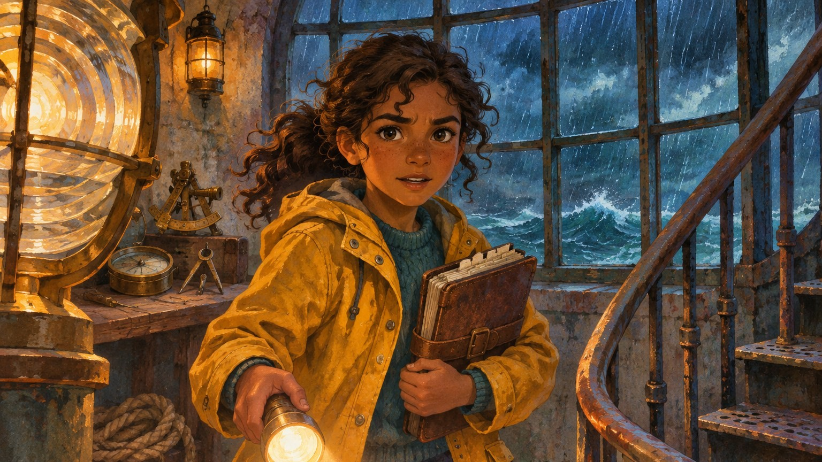
Mira's Crew
SCENE 8 OF 8
Mira grabbed the logbook and a flashlight. Her hands were shaking, but she knew where to start.
"Ratios," she whispered. "Everything in this lighthouse runs on ratios and rates. The lens, the generator, the radio."
She looked around the dark room. She couldn't fix it alone. She needed a crew.
That's where you come in.
Talk about it: What tools from Pop's logbook do you think Mira's crew will need?
Notes:
This is the hook for the escape room. Collect predictions on chart paper: ratio tables, equal groups, unit rates, double number lines. You'll revisit them in the debrief.
Say: Tomorrow, you are Mira's crew. Today, we practice with the tools from Pop's logbook.

Slide 14

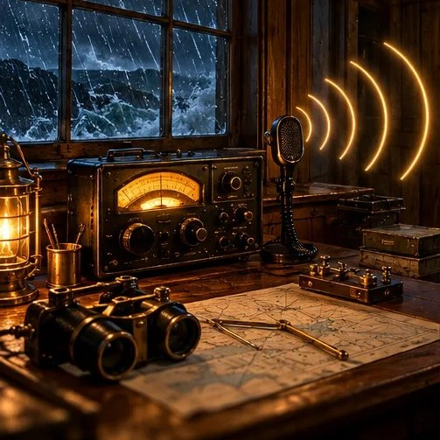
After Reading: Mira’s Crew
What tools from Pop’s logbook will Mira’s crew need?
Which word from the story could you explain to a friend?
Start your Word Bank: pick three words, explain each in your own words, and add an example.
Notes:
Record answers on chart paper titled "Tools Mira’s Crew Will Need." You’ll return to it in the debrief. Expected: ratio tables, equal groups, unit rates, double number lines.
Then students start the Word Bank {S-1}: three terms, each with a meaning in their own words and an example from the story.
Say: Tomorrow, you are Mira’s crew. Next, we practice with the tools from Pop’s logbook.

Slide 15
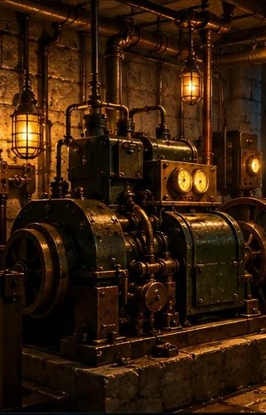
Building the Toolkit
DAY 1 · LESSON 1
Practice the tools you’ll need in the escape room
Notes:
45 minutes: warm-up 5, three tools 24, getting ready for the climb 8, reflection 7. Partners work at their desks. The problems use new situations so the game’s own puzzles stay fresh. Test the game on a school device and bookmark it on shared devices.

Slide 16

Guiding Question
What tools can help us find a missing amount when a ratio or rate stays the same?
Student responses…
Notes:
Post the Guiding Question and record students’ first ideas. Return to this slide at the end of the lesson to add to or revise the list.

Slide 17

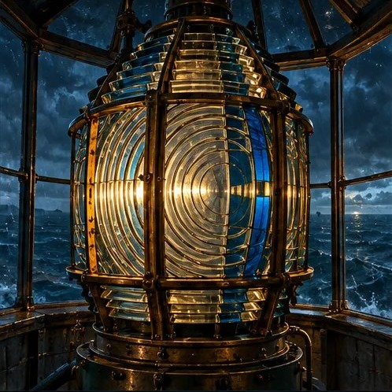
Warm-Up: Back to the Lantern Room
Pop’s lens: 2 blue for every 3 gold
Say it three ways: blue to gold, gold to blue, blue to all.
What happens if we add 1 to each number?
Notes:
Pairs describe Pop’s lens pattern three ways: 2 : 3 (blue to gold), 3 : 2 (gold to blue), 2 out of 5 (blue to all).
Ask: What would happen to the lens if we added 1 to each number? 3 : 4 is a different pattern. That’s why Pop says to multiply, never just add.

Slide 18



Three Tools from Pop’s Logbook
Work with your partner. We’ll do one tool at a time, then check in together.
Tool 1 · Equal groups
Tool 2 · Ratio tables
Tool 3 · Unit rates
Color equal groups to build a bigger flag. Gets you ready for the Lens Room.
Fill in tables for lemonade and muffins. Gets you ready for the Generator Room.
Find the amount for 1 minute. Gets you ready for the Radio Room.
Notes:
Partners stay at their desks and work on one tool at a time, about 6 minutes each, using the Toolkit Practice sheet {1-1}. After each tool, bring the class together for a 2-minute check-in.
If you prefer stations, split the pairs into three groups and rotate every 8 minutes. Hold the muffin discussion until everyone has finished Tool 2.

Slide 19
Tool 1: Equal Groups
A flag has 3 red stripes for every 2 white stripes. A big flag has 15 stripes. How many are red?
One group
The big flag
How many groups of 5 fit in 15 stripes?
Notes:
About 6 minutes, then a 2-minute check-in. Answer: 3 groups of 5, so 9 red and 6 white.
Ask: How many stripes in one group? 5. How many groups fit in 15? 3.

Slide 20
Tool 2: Ratio Tables
Lemonade: 3 scoops for every 4 cups
Muffins: 4 eggs make 6 muffins
Scoops | 3 | 6 | ?
Cups | 4 | 8 | 20
Muffins | 6 | 3 | 9
Eggs | 4 |  | ?
Adding?
6 → 9 muffins is +3, so 4 + 3 = 7 eggs?
Multiplying?
6 → 9 muffins is ×1.5. Or go through 3 muffins first.
Notes:
About 6 minutes, then a 2-minute check-in focused on the muffins. Lemonade: 15 scoops (20 cups is 5 × 4 cups, so 5 × 3 scoops).
Muffins: 6 eggs. 9 muffins is 1.5 × 6 muffins, so 4 × 1.5 = 6. Or go through 3 muffins: 2 eggs, then ×3.
At the check-in, ask: Someone said 7 eggs. why is it tempting? It adds 3. This is the same mistake the Lantern Check looks for.

Slide 21
Tool 3: Unit Rates
A pump moves 28 L in 4 minutes. What is the unit rate? How long to move 63 L?
Which runner is faster: 20 laps in 5 minutes, or 18 laps in 3 minutes?
0
1
2
3
4
Minutes
Liters
0
?
?
?
28
A unit rate is the amount for every 1 of something.
Notes:
About 6 minutes, then a 2-minute check-in. Pump: 28 ÷ 4 = 7 liters per minute; 63 ÷ 7 = 9 minutes.
Runners: 18 laps in 3 minutes (6 per minute) beats 20 laps in 5 minutes (4 per minute).
Point to the double number line: Where do you see 7 liters per minute?

Slide 22


Your Jobs and Helpers
Jobs
Practice
Hints
Logbook
The Driver taps. The Navigator reads aloud. Switch jobs after each room.
The pencil opens a short warm-up in each room.
Tap the lightbulb for a hint. Hints are always free.
Both partners write every clue in their own logbook.
Notes:
Getting ready for the climb (8 minutes). Driver taps; Navigator reads aloud; both partners write every clue in their own logbook; switch at every room. Hand out the Beacon Logbook {2-1} now.
Normalize the helpers: strong problem solvers use hints and practice.

Slide 23

Reflect: Our Toolkit
Which tool felt most useful? Which felt hardest?
Why does adding the same amount to both rows break a ratio?
Tomorrow
The lighthouse goes dark. You’ll have one class period to light it again.
Notes:
Add answers to the "Tools Mira’s Crew Will Need" chart.
Why does adding the same amount break a ratio? The "for every" changes. 2 packs : 3 flashes is not the same as 3 : 4.

Slide 24
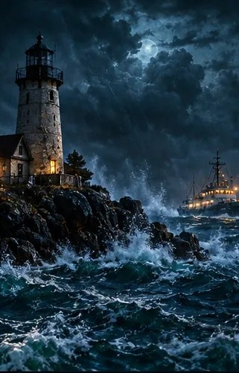
The Escape
DAY 2 · LESSON 2
Play all four rooms in one class period
Notes:
One full 45-minute period. The final room depends on clues from the first three, and the game does not save progress if the tab closes. One device per pair with the game bookmarked, plus 2 spares. Carry the Escape Day Card. Absent students: see the guide’s make-up plan and Paper Rooms {2-2}.

Slide 25

General Preparation
Form pairs
Test devices
Have handouts ready
Give each pair one device. The Driver taps and the Navigator reads aloud.
Open the game on a school device before class. Check that the content filter lets it through.
Logbooks from Day 1, a few Paper Rooms copies, and your Escape Day Card.
Notes:
Pairs work best: one device per pair. The Driver taps and the Navigator reads aloud. Both partners write every clue in their own logbook.
The game does not save progress if a tab closes or refreshes, so Lesson 2 must be one full class period.

Slide 26
Guiding Question
Can we use ratios and rates to light the beacon before the ship reaches the reef?
Student responses…
Notes:
Post the Guiding Question and record students’ first ideas. Return to this slide at the end of the lesson to add to or revise the list.

Slide 27

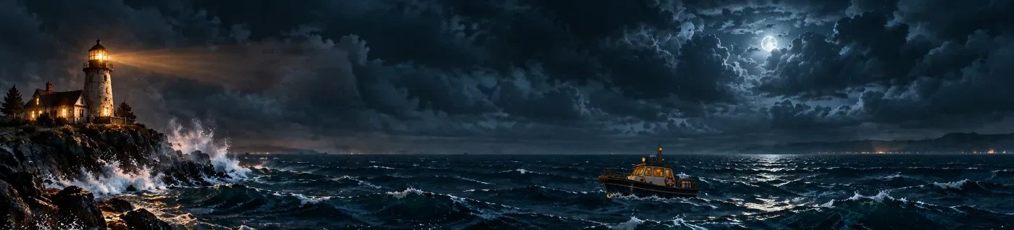
Remember Mira?
A rescue ship is 3 miles from the reef. The storm broke the lens, the generator and the radio. Fix all three, then send a signal before the ship reaches the rocks.
You are Mira’s crew. Open the game and start climbing!
Notes:
Read the mission aloud, then send pairs to their devices.
Say: The lighthouse is dark, the ship is 3 miles out, and you are Mira’s crew. Hints are free. Strong problem solvers use them.

Slide 28
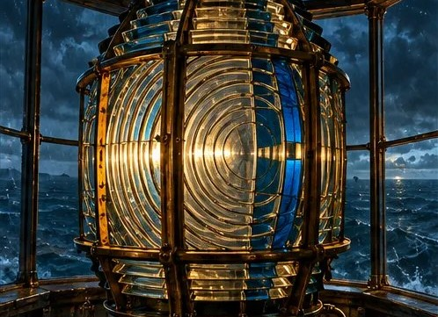
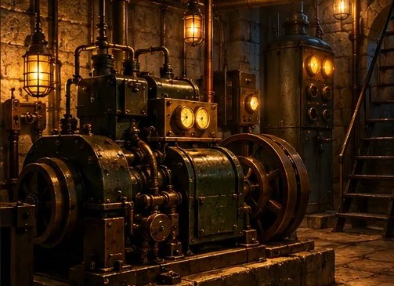
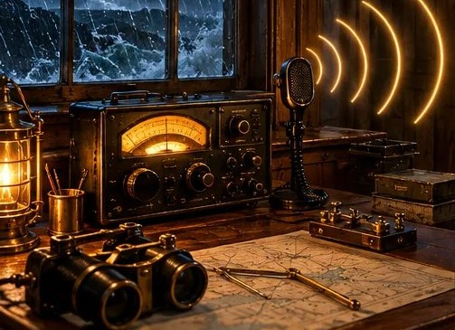
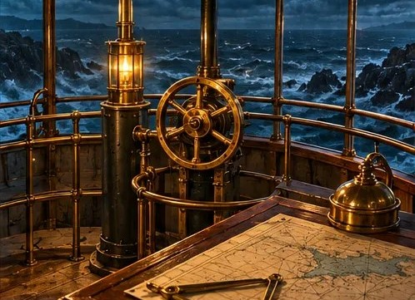
Today’s Climb
1
2
3
4
Lens Room
Generator
Radio Room
Signal Gallery
Match a ratio
Fill a ratio table
Find a unit rate
Set the signal
Logbook: both partners record every clue. The Signal Gallery needs all three.
Don’t close or refresh the tab: the game doesn’t save your progress.
Notes:
Pairs move at their own pace. Suggested timing for a 45-minute period: settle 3, Lens 10, Generator 8, Radio 8, Signal Gallery 12, huddle 4. Use these to spot pairs who are stuck, not to rush anyone.
Answers for circulating:
Lens: 8 blue, 12 gold (the 4 stuck gold panels count).
Generator: 15 flashes. Watch for 14 (adding 2).
Radio: 6 beeps per minute; 7 minutes. Watch for 3 ÷ 18.
Gallery: 6 blue : 9 gold; 12 flashes; 6 minutes (before 6.5).

Slide 29
Before You Open Each Door
1
The Navigator explains how you know the answer works
2
Pick your strategy in the game
3
Both partners write the clue and strategy
4
Switch jobs
5
In the Signal Gallery, ask: What stayed the same? What changed?
Notes:
Leave this slide up while pairs play. Before a pair unlocks a door, ask the Navigator to explain the last answer.
Early finishers: start the Design a Room planner {3-2}. Pairs who fall behind: point them to hints and check in. If time runs out, they finish at the start of Lesson 3 using their logbook.

Slide 30
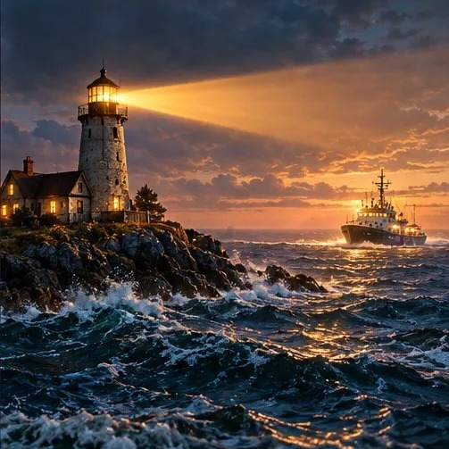
Huddle
Which room was hardest? Why?
Which clue helped you most in the Signal Gallery?
Notes:
Celebrate the rescue. Keep it to 4 minutes. Collect logbooks: they are your only record of who finished each room.

Slide 31
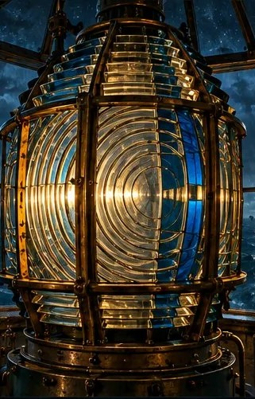
Signal Debrief
DAY 2 · LESSON 3
Why did our patterns still work?
Notes:
45 minutes: Back to Gull Point 5, strategy share 12, connecting the models 8, the storm’s big idea 7, mistakes 5, Lantern Check 8. Copies: Debrief Reflection {3-1} and Lantern Check {3-3} per student; Design a Room {3-2} per pair for the extension. Before class, pick two or three anonymous wrong answers you saw during play.

Slide 32
Guiding Question
Why did the patterns we found still work after the storm changed every amount?
Student responses…
Notes:
Post the Guiding Question and record students’ first ideas. Return to this slide at the end of the lesson to add to or revise the list.

Slide 33

Back to Gull Point
EPILOGUE
The Sea Wren slipped past the reef and into the harbor, its lights blinking a thank-you.
At dawn, Pop climbed the tower stairs. The beacon was shining. On the desk lay his logbook, now full of new tables, number lines and clues in handwriting he didn’t recognize.
Pop smiled. “Looks like Gull Point has a new crew of keepers.”
Talk about it: What would you want Pop to notice in your logbook?
Notes:
Part 1 of the debrief (5 minutes). Read the epilogue aloud. Pairs who didn’t finish the game finish now; everyone else adds a tick on the chart paper for each strategy they chose in the game.

Slide 34

Lens Room: How Did You Solve It?
Equal groups
Part of the whole
Try and check
I made 4 groups of 2 blue and 3 gold.
2 of every 5 spots are blue, so 8 of 20 are blue.
I tried colors and checked until it worked.
Which strategy would still work for a lens with 100 spots? Why?
Notes:
Part 2: strategy share (12 minutes for all three rooms). Tally the strategies pairs picked in the game. Ask a pair from each to share.
Which would still work for a 100-spot lens? Groups or fractions; guess-and-check takes too long.
Draw the tape diagram: 4 groups, each 2 blue + 3 gold.

Slide 35
Generator Room: Three Paths
Power packs | 4 | 8 | 10
Flashes | 6 | 12 | 15
Find 1 pack
1 pack → 1.5 flashes, then ×10
Combine columns
8 packs + 2 packs, so 12 + 3 flashes
Try and check
Try numbers until the pattern works
Why is 14 flashes tempting? Why is it wrong?
Notes:
Draw each path as arrows on one class ratio table.
Which is fastest? Combining columns avoids decimals; the value for 1 works for any number.
Why is 14 tempting, and why is it wrong? It adds 2 to both rows, but 2 packs make 3 flashes, not 2.

Slide 36
Radio Room: Count or Divide?
Minutes
0
1
2
3
4
5
6
7
0
6
12
18
24
30
36
42
Beeps
Counting up by 6 and dividing 42 by 6 gave the same answer. Why?
Notes:
18 ÷ 3 = 6 beeps per minute; 42 ÷ 6 = 7 minutes.
Why do counting up and dividing give the same answer? Division counts how many groups of 6 fit in 42.

Slide 37
Connecting the Models
Three ways to show the same idea: 2 power packs make 3 flashes
Tape diagram
Ratio table
Double number line
0
2
4
6
Packs
Packs | 2 | 4 | 10
Flashes | 3 | 6 | 15
Flashes
0
3
6
9
2 groups: 4 packs, 6 flashes
packs (top) · flashes (bottom)
Where do you see “2 packs make 3 flashes” in each picture?
Notes:
Part 3 (8 minutes). Ask: Where do you see "2 packs make 3 flashes" in each picture? Have students come up and point.
Then: Which model would you pick for the Radio Room? Many choose the double number line, because time runs along a line.
Say: These are three pictures of the same idea. Pick the one that helps you think.

Slide 38

The Storm’s Big Idea
What stayed the same?
Lens: 2 blue : 3 gold
Generator: 2 packs : 3 flashes
Radio: 6 beeps per minute
What changed?
Only 15 lens spots remain
Lightning took 2 of 10 power packs
New message: 36 beeps
The ship arrives in 6.5 minutes
Notes:
Part 4 (7 minutes). Build the class chart together, then ask: Why could the crew still solve it? The ratios and rates didn’t change, only the amounts.
Where else does a ratio stay the same while amounts change? Doubling a recipe, steady speed, mixing paint, map scales.
Students write the big idea on the Debrief Reflection {3-1}.
Same: the ratios and the rate (2 blue : 3 gold; 2 packs : 3 flashes; 6 beeps per minute).
Changed: 15 lens spots, 8 power packs, a 36-beep message, ship arrives in 6.5 minutes.
Signal answers: 6 blue : 9 gold; 12 flashes; 6 minutes.

Slide 39
Mistakes Worth Learning From
“14 flashes”
“16 gold”
“8 minutes”
Generator Room: 10 packs make how many flashes?
Lens Room: how many gold lights in the 20-spot lens?
Radio Room: how long for 42 beeps?
Why might someone think this? What would you tell them?
Notes:
Part 5 (5 minutes). Swap in anonymous wrong answers you actually saw during play if you have them.
14 flashes: adds 2 to both rows; but 2 packs make 3 flashes, not 2.
16 gold: forgets that the 4 stuck panels are already gold; the lens needs 12 gold in all.
8 minutes: 8 × 6 = 48 beeps, more than the 42 needed.
Point out what makes each mistake reasonable before correcting it.

Slide 40
Lantern Check
Q1
The lamp burns 6 L of oil every 8 hours. How much does it burn in 12 hours?
Q2
Lantern A runs 18 hours on 3 L. Lantern B runs 20 hours on 5 L. Which one gets more hours from each liter?
How sure are you?
Guessing
Kind of sure
Sure
Notes:
Part 6: Lantern Check {3-3}, 8 minutes. Students work alone and circle a confidence level after each question.
Q1 answer: 9 L (12 hours is 1.5 times 8 hours, so 6 L × 1.5). An answer of 10 L adds instead of multiplying.
Q2 answer: Lantern A (6 hours per liter vs. 4).
Look at score and confidence together. The guide’s Reading the Results table suggests next steps.

Slide 41
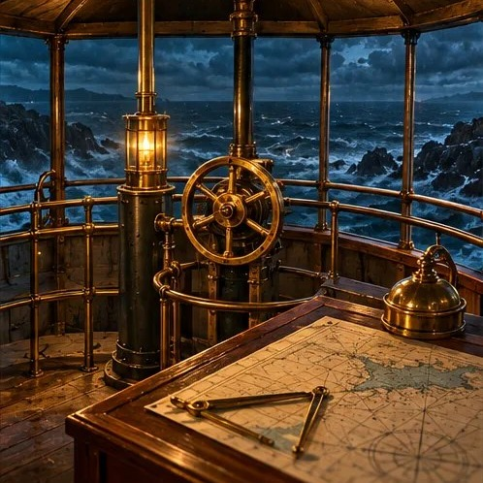
Back to the Crew’s Tools
Which of our Day 1 predictions turned out to be right?
What tool would you add to the list now?
Finish your Debrief Reflection.
Notes:
Closing. Return to the "Tools Mira’s Crew Will Need" chart from Day 1. Ask which predictions turned out to be right and what students would add.
Students finish the Debrief Reflection {3-1}.

Slide 42
Extension: Design a Room
Invent
Write
Swap
Pick a new part to fix: a fog horn, a fuel tank, a supply boat.
Write one ratio or rate puzzle, an answer key and three hints.
Trade rooms with another pair. Solve theirs, then give feedback.
Challenge: Add a storm twist, where the amounts change but the ratio stays the same.
Notes:
Extension after the debrief. Pairs use the Design a Room planner {3-2}. Push for a true ratio or rate (not "3 more each time") and hints that move from a question to a concrete next step, like the game’s hints. Pairs finish for homework if needed, then swap rooms and solve them as the next day’s warm-up.
Challenge: add a storm twist, where the amounts change but the ratio stays the same.

Slide 43

The Ship Is Safe!
MISSION COMPLETE
Thank you, crew. Where else could ratios and rates save the day?
Notes:
Possible answers: recipes, sports stats, unit prices at the store, medicine doses, map scales, speed.

